Slide 1

Strengthening our Inclusive Workplace
SS
by Seher Subra

Slide 2
We are an inclusive school.

Slide 3
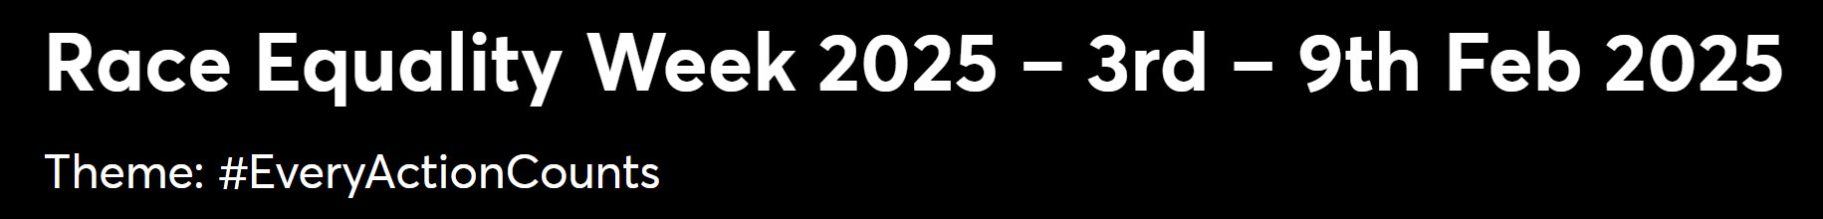

Slide 4
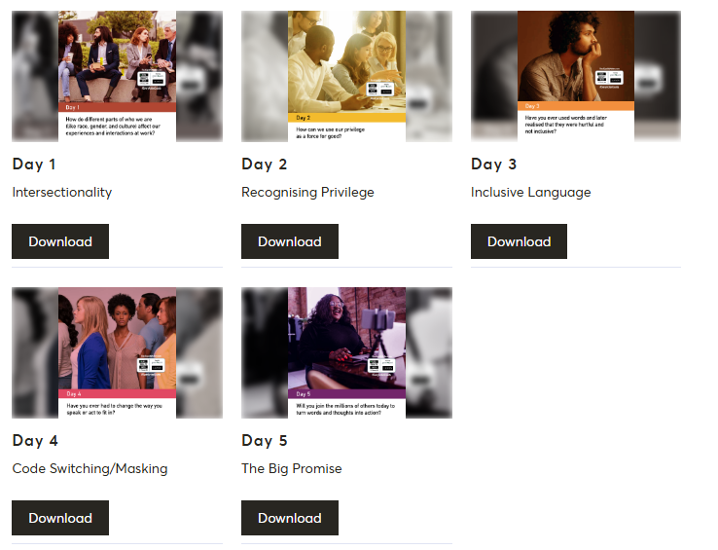
The 5-Day Challenge:

Slide 5

Introduction
Importance of Exploration
Recognizing Privilege
Power of Words and Actions
Understanding how race, gender, and culture shape our experiences at work is essential for creating a truly inclusive environment.
We must acknowledge privilege and use it to dismantle inequality and advocate for positive change in the workplace.
Our language and actions play a significant role in shaping an inclusive workplace. It is vital to be mindful and use our influence to create a more just and equitable environment for everyone.

Slide 6
How Identity Affects Workplace Experiences
Race, Gender, and Culture
Unconscious Bias
Importance of Diversity
These factors influence perceptions, opportunities, and interactions at work. It is crucial to be aware of how they shape our experiences and to challenge any form of discrimination or bias.
Unconscious bias can affect decisions related to hiring, promotions, or daily interactions. It is important to recognize and address these biases to create a fair and equitable workplace.
Diversity fosters creativity, innovation, and a sense of belonging. It brings different perspectives and experiences to the table, enriching the workplace.

Slide 7

Recognizing Privilege
1
What is Privilege?
2
Privilege in the Workplace
Privilege refers to unearned advantages and benefits granted to certain groups based on their race, gender, socioeconomic status, or other factors.
It manifests as easier access to opportunities, smoother interactions, and fewer barriers to advancement.
3
Recognizing Your Own Privilege
4
Intersectionality
Reflect on how your privilege influences your experiences and opportunities. This self-awareness is vital for understanding how to use privilege for good.
Recognizing how overlapping identities (race, gender, class) create unique challenges and privileges is critical to understanding the complexities of inclusivity.

Slide 8
Using Privilege as a Force for Good
Leveraging Privilege
Promoting Inclusive Practices
Being a Proactive Ally
Those with privilege can actively work to dismantle inequality and advocate for others. It's about using your influence and voice to create a more just and equitable society.
Mentorship, advocating for equal pay, and amplifying marginalized voices are ways to use privilege for positive change. We can actively promote inclusive practices in the workplace.
Stand up for colleagues facing discrimination, offer support, and create an inclusive environment. This involves being a proactive ally and using your privilege to help those who are disadvantaged.

Slide 9
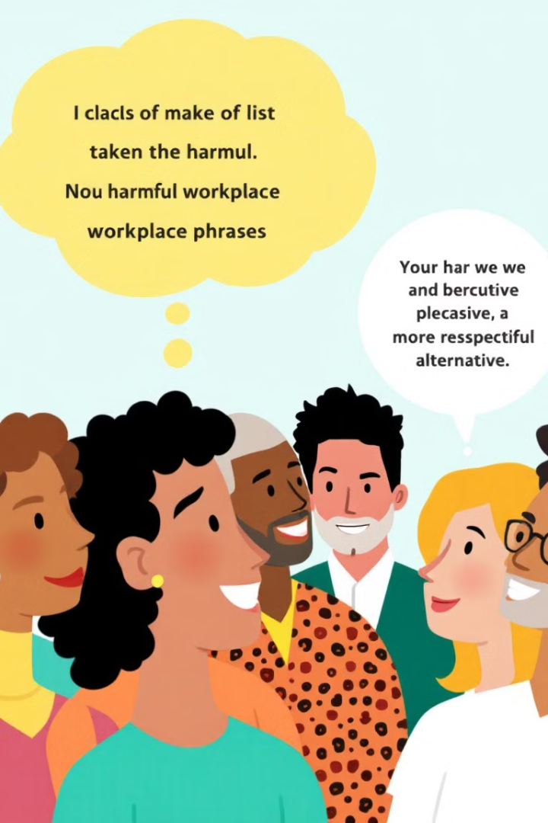




The Impact of Words
Unintentional Hurt
Microaggressions
Have you ever used words that were unintentionally hurtful or exclusive? We must be mindful of our language and its impact on others.
Exploring microaggressions, which are subtle, often unconscious, and often insensitive comments or behaviors that can affect individuals in the workplace. We must be aware of these and challenge them.
Reflecting on Language
Inclusive Alternatives
It is crucial to reflect on our language and ensure it is inclusive and respectful. We need to be mindful of the impact of our words on others.
Examples of common phrases to avoid and alternatives that are more inclusive can help us create a more welcoming environment for everyone.

Slide 10

Changing How We Speak and Act
1
Self-Awareness
Adapting your language and behavior to create an inclusive workplace is essential for fostering a more equitable and respectful environment for everyone.
2
Adjusting Behaviour
Sometimes we adjust our behavior due to social and cultural pressures to fit in. It is important to be aware of how these pressures affect our communication and authenticity.
3
Embracing Vulnerability
Being open to learning from mistakes and making adjustments in behavior is vital for personal growth and for creating a more inclusive and understanding environment.

Slide 11





Turning Words and Thoughts into Action
Words to Action
Words are powerful, but action is essential. We must translate inclusivity into tangible workplace changes to truly make a difference.
Open Dialogue
Encouraging open dialogue about diversity and inclusion in the workplace is key to fostering understanding, empathy, and change.
Join the Movement
Will you commit to taking action and fostering an inclusive culture at work? It is a collective responsibility to create a more equitable and just workplace for all.
Call to Action
Share your intentions for positive change, support colleagues, and advocate for equal opportunities for all. Together, we can create a more inclusive workplace.

Slide 12

REW 2025

Slide 13



Conclusion: We are an inclusive school
1
Continue to Strengthen our Inclusive Workplace
2
Recognizing Identity & Privilege
3
Leveraging Privilege for Inclusivity
We must choose to act today to shape a more inclusive, empathetic, and supportive workplace for tomorrow.
Thank you for your attention and commitment to making a difference.

